Slide 1



PIC16F18877 DEVELOPMENT KIT
INTRODUCTION & DEMONSTRATION

Slide 2
CONTENTS
MICROCHIP COMPANY INTRODUCTION
PIC16F18877 OVERVIEW
TRAINING PROGRAM
DEMONSTRATION

Slide 3
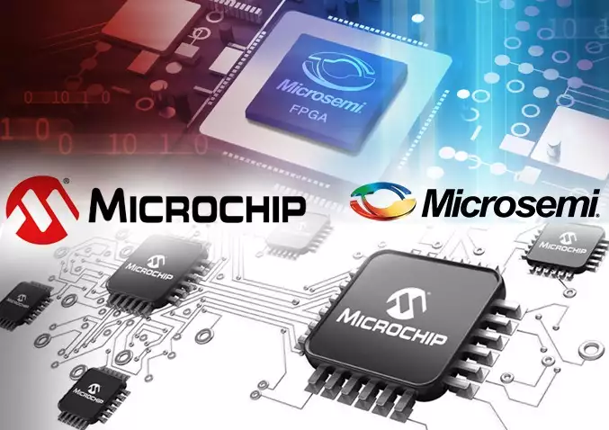

MICROCHIP COMPANY INTRODUCTION
MICROCHIP COMPANY INTRODUCTION
PIC16F1xxxx OVERVIEW
TRAINING PROGRAM
DEMONSTRATION
Leading in microcontroller
PIC, dsPIC, AVR, MIPS, ARM.
Acquisitions
Atmel: MCU, MPU, Touch, RF.
Micrel: Power supply & management.
ISSC: Memory.
Supertex: HV analog and mixed signal.
EqcoLogic: Data and video transceivers.
Microsemi: FPGA & SoC (March 1st, 2018).
Number one in 8-bit MCU

Slide 4
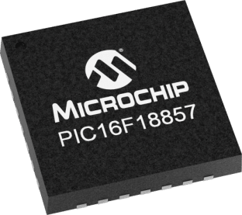
PIC16F1xxxx OVERVIEW
MICROCHIP COMPANY INTRODUCTION
PIC16F1xxxx OVERVIEW
TRAINING PROGRAM
DEMONSTRATION
Summary
PIC16F1xxxx MCU offer eXtreme Low-Power.
LCD drive, RTCC, 12-bit ADC.
Core Independent Peripherals.
Memory access partition.

Slide 5
PIC16F1xxxx OVERVIEW
MICROCHIP COMPANY INTRODUCTION
PIC16F1xxxx OVERVIEW
TRAINING PROGRAM
DEMONSTRATION
Feature
Parameters | PIC16F18857 | PIC16F886
Flash/RAM/EEPROM | Up to 56KB/4KB/256B | Up to 14KB/368B/256B
Speed | 8MIPS@32MHz (Internal) | 5MIPS&20MHz (External)
ADC/DAC resolution | 12-bit/5-bit | 10-bit/0
Timer 8/16bit | 2/2 | 2/1
CCP/PWM | 2/2 – 10-bit | 2/0 - 10-bit
CWG/CLC | 1/4 | 0/0
Zero cross detect | Yes | No
UART/SPI/I2C | 2/1/1 | 1/1/1
Peripheral pin select | Yes | No

Slide 6
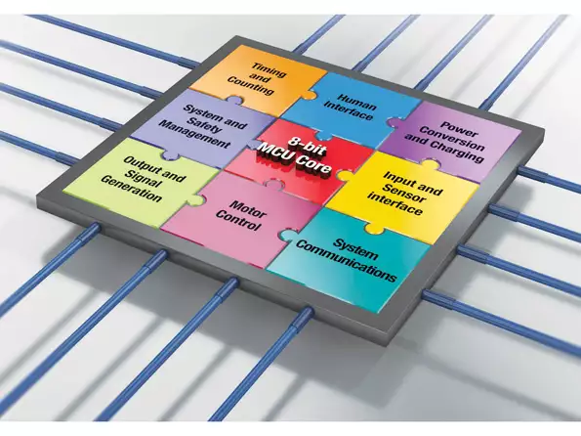
TRAINING PROGRAM
MICROCHIP COMPANY INTRODUCTION
PIC16F1xxxx OVERVIEW
TRAINING PROGRAM
DEMONSTRATION
What is a microcontroller?
How to use a microcontroller?
How to make an application?

Slide 7
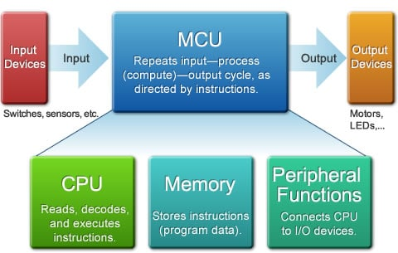
TRAINING PROGRAM
MICROCHIP COMPANY INTRODUCTION
PIC16F1xxxx OVERVIEW
TRAINING PROGRAM
DEMONSTRATION
What is a microcontroller?
MCU Basic Structure/Operation.
Peripheral Circuitry.
Programming Language/
Software Development Environment.
Peripheral Circuitry Control.
Interrupt Processing.

Slide 8
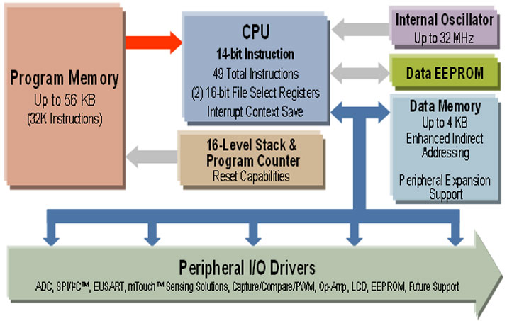
TRAINING PROGRAM
MICROCHIP COMPANY INTRODUCTION
PIC16F1xxxx OVERVIEW
TRAINING PROGRAM
DEMONSTRATION
How to use a microcontroller?
How to configure?
How to manage memory?
How to control I.Os & peripherals?
MPLAB X IDE & XC8 compiler.

Slide 9
TRAINING PROGRAM
MICROCHIP COMPANY INTRODUCTION
PIC16F1xxxx OVERVIEW
TRAINING PROGRAM
DEMONSTRATION
MPLAB X IDE & XC8 compiler:
Run on a PC (Windows®, Mac OS®, Linux®).
Work on low level: ASM, register (in C).
Work on high level: API using framework.
Free license for student.

Slide 10
TRAINING PROGRAM
MICROCHIP COMPANY INTRODUCTION
PIC16F1xxxx OVERVIEW
TRAINING PROGRAM
DEMONSTRATION
How to make an application?
Collect demands
Analyze
Design
Test
Adjust
Release

Slide 11
TRAINING PROGRAM
MICROCHIP COMPANY INTRODUCTION
PIC16F1xxxx OVERVIEW
TRAINING PROGRAM
DEMONSTRATION
Duration
2 Shifts x 4 Weeks (18 hours).
Main content
Configure Chip.
Memory partition & accessing.
GPIO control.
Peripherals: Timer, ADC, PWM, UART, I²C, SPI, Interrupt.
Applications: Real time control.

Slide 12
DEMONSTRATION
MICROCHIP COMPANY INTRODUCTION
PIC16F1xxxx OVERVIEW
TRAINING PROGRAM
DEMONSTRATION
Overview
Arduino size and pinout.
Compatible with Arduino shields.
Feature
Programmer & Debugger onboard.
External power supply up to 1.5A.
More connectivity.

Slide 13
DEMONSTRATION
MICROCHIP COMPANY INTRODUCTION
PIC16F1xxxx OVERVIEW
TRAINING PROGRAM
DEMONSTRATION
Electrical
5V from micro USB or external power up to 1.5A.
Logic 5V/3.3V.
Demo application
MCU will connect to server and send values of sensor included:
Temperature & Humidity.
Proximity and Ambient.
Accelerometer.
GPS & RTCC.
Server will send command to control LEDs on MCU board.

